Slide 1
Linking Basque lexical resources
David Lindemann
Universität Hildesheim /
UPV/EHU Univ. of the Basque Country

Slide 2
Basque Language
Minority language
1 million speakers
Co-official in part of the Basque territory, not in Spain nor EU
NLP resources: very good
e-Lexicography: quite good
Retro-digitizing / historical Lexicog:
(Still) not good at all

Slide 3
My idea
Merge existing NLP lexical resources and dictionaries
  Via Lemma Sign (string)
    …whenever there is no other chance
  Via homonym disamb. lempos entity
    …would be slightly better
  Via word sense ID
    …would be very good

Slide 4
Basque lemma signs
Corpus based frequency lemma list
  56.000 items, with freq. data

Slide 5
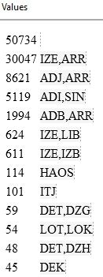
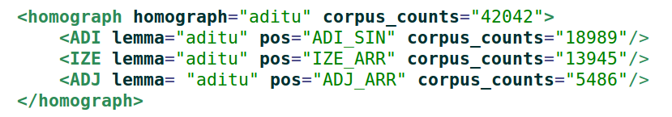
Lempos-entities
Lempos-entities from BasqueWAC
  Basque POS tagger (uses Basque NLP lexicon „EDBL“)
  50.700 items, with freq. data

Slide 6
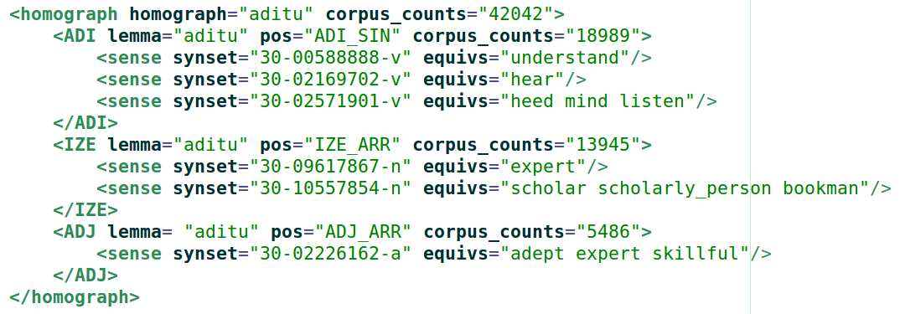
Word Senses
Basque WordNet „EusWN“
  38.300 word senses

Slide 7
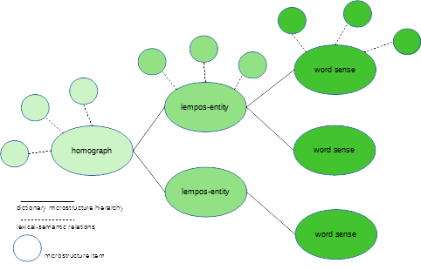
Basic XML schema

Slide 8
Basic XML schema

Slide 9
Resources to merge
EusLemStd Frequency list
EDBL lempos-entities
Basque WordNet „EusWN“
General Basque Dictionary „OEH“
Monolingual „Euskal Hiztegia“
…many more

Slide 10
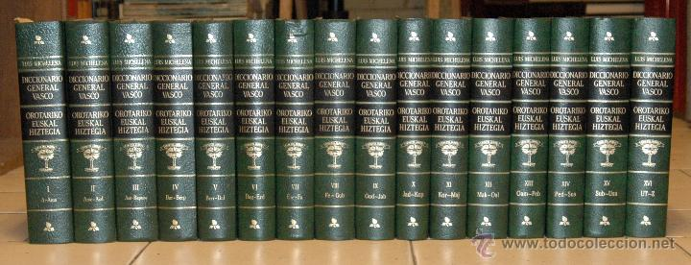
Unlocking the biggest treasure
General Basque Dictionary „OEH“
  Follows today‘s standard lemmatization
  Contains all literat. & lexicog. until 1980

Slide 11
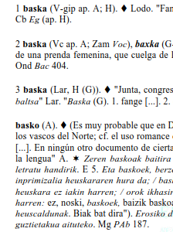

General Basque Dict. „OEH“
PDF version
16.364 pages
Problems to address
  Homonyms
  POS mixed up
  Very rich microstructure
  Poor layout markup

Slide 12
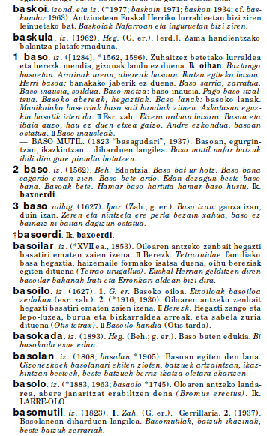
Monolingual „Euskal Hiztegia“
PDF
790 pages
Additional problems:
  2 columns
Advantage:
  XML version theoretically available

Slide 13
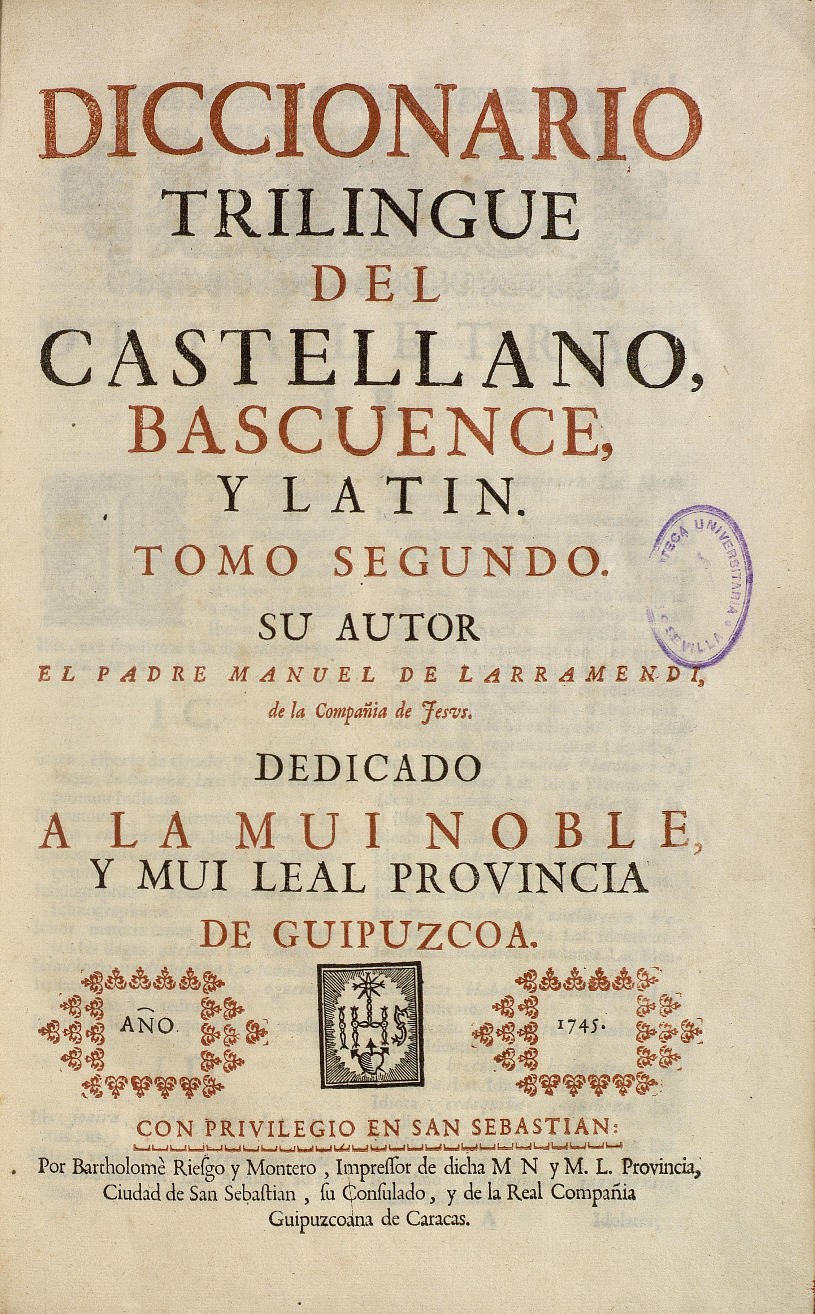
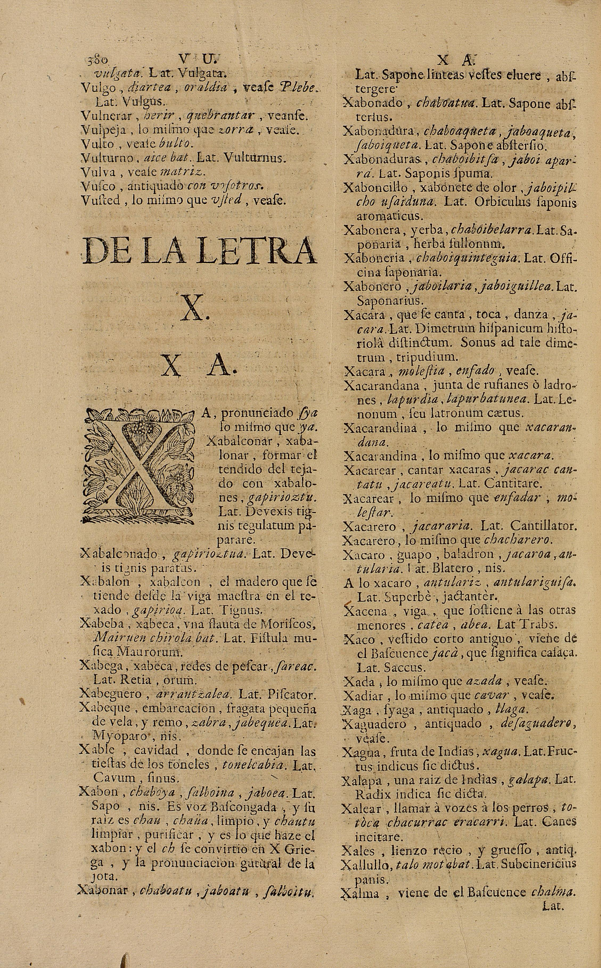
…and there is more…

Slide 14
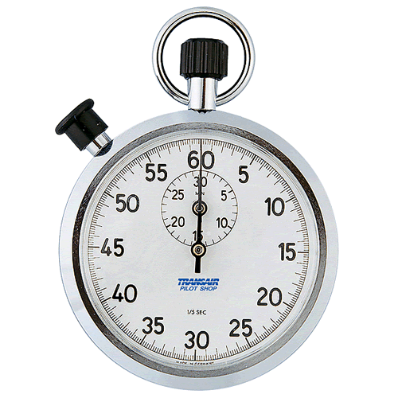
Time’s Up!
About me:
  Name: David Lindemann
  Institution: Universität Hildesheim
  Social media profiles etc.:
  https://www.uni-hildesheim.de/~linde002/
  Quick bio:
  1996-2003 Political Science (Berlin Germany)
  2006-2010 BA Translation Studies (Basque Country)
  2010-2012 MA Basque Philology (Basque Country)
  2012-2015 PhD Bilingual Lexicography (Basque C.)
  2016-2017 Postdoc Researcher (Basque Country)
  2017- Lecturer / Researcher (Hildesheim Germany)

